Slide 1
Linear regression with one variable
Model representation

Slide 2


Housing Prices
(Portland, OR)
Price
(in 1000s of dollars)
Size (feet²)
Supervised Learning
Given the “right answer” for each example in the data.
Regression Problem
Predict real-valued output

Slide 3




Training set of
housing prices
(Portland, OR)
Size in feet² (x) | Price ($) in 1000's (y)
2104 | 460
1416 | 232
1534 | 315
852 | 178
… | …
Notation:
m = Number of training examples
x’s = “input” variable / features
y’s = “output” variable / “target” variable

Slide 4






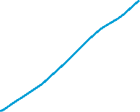




Training Set
How do we represent h ?
Learning Algorithm
Size of house
h
Estimated price
Linear regression with one variable.
Univariate linear regression.

Slide 5
Cost function
Linear regression with one variable

Slide 6
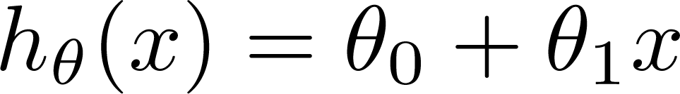

Training Set
Size in feet² (x) | Price ($) in 1000's (y)
2104 | 460
1416 | 232
1534 | 315
852 | 178
… | …
Hypothesis:
‘s: Parameters
How to choose ‘s ?

Slide 7
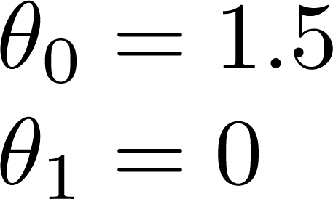
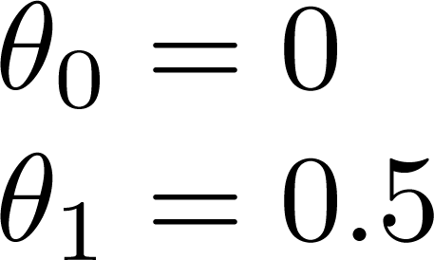
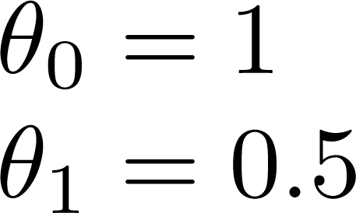



Slide 8
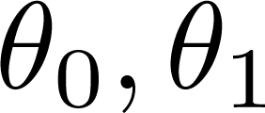


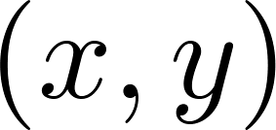







y
x
Idea: Choose so that is close to for our training examples

Slide 9
Linear regression with one variable
Cost function intuition I

Slide 10
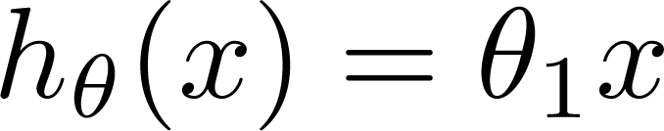

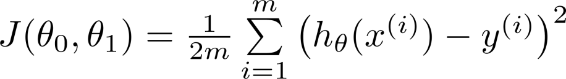
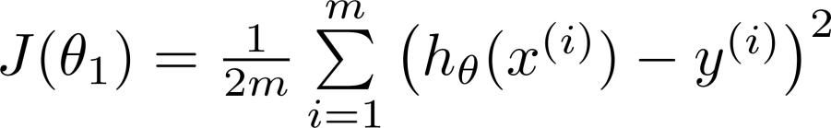
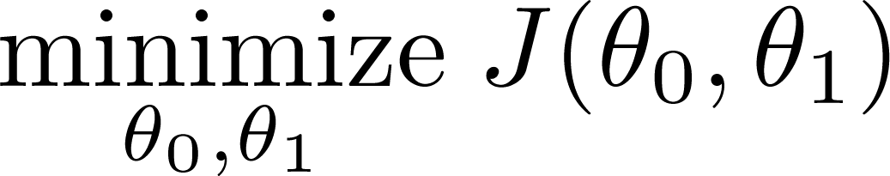
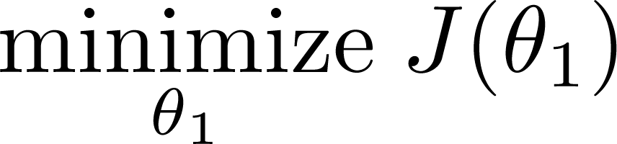






Simplified
Hypothesis:
Parameters:
Cost Function:
Goal:

Slide 11







(for fixed , this is a function of x)
(function of the parameter )
y
x

Slide 12



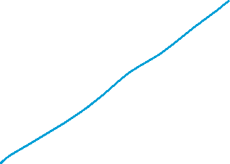



(for fixed , this is a function of x)
(function of the parameter )
y
x

Slide 13

(for fixed , this is a function of x)
(function of the parameter )
y
x

Slide 14
Linear regression with one variable
Cost function intuition II

Slide 15
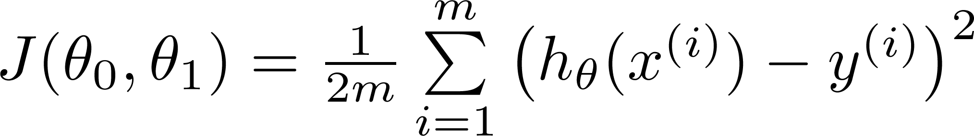


Hypothesis:
Parameters:
Cost Function:
Goal:

Slide 16
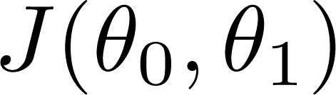


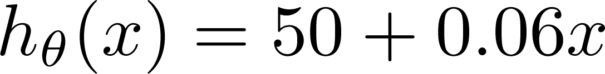

(for fixed , this is a function of x)
(function of the parameters )
Price ($)
in 1000’s
Size in feet² (x)

Slide 17
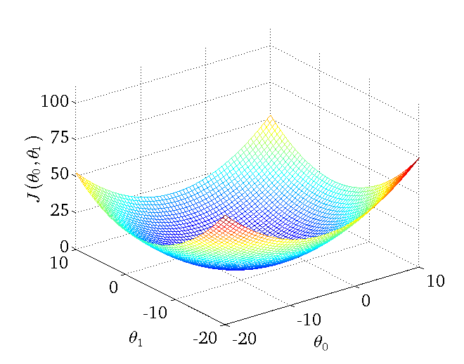




Slide 18
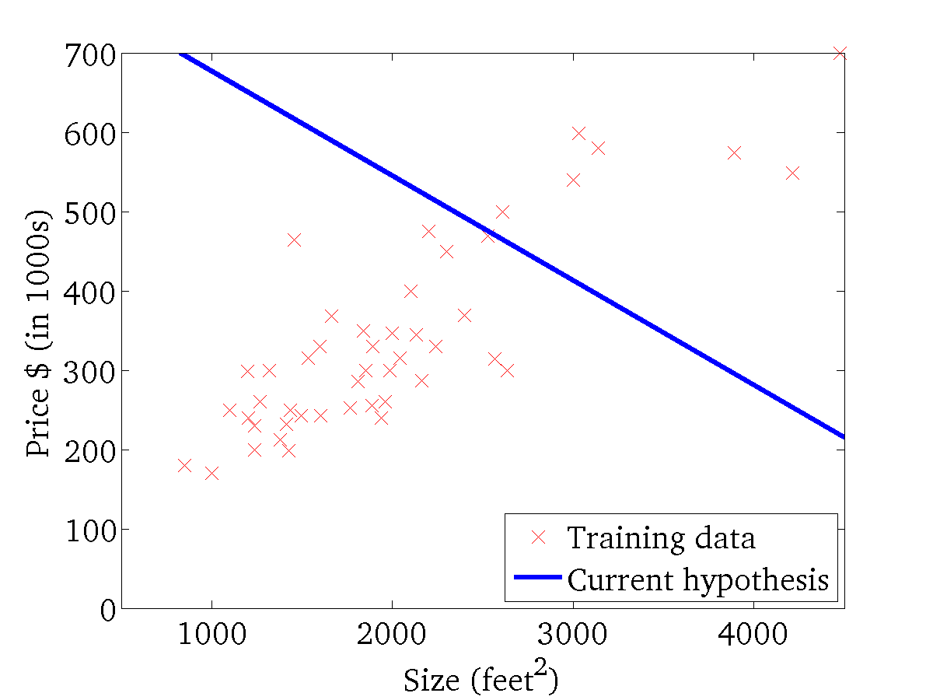
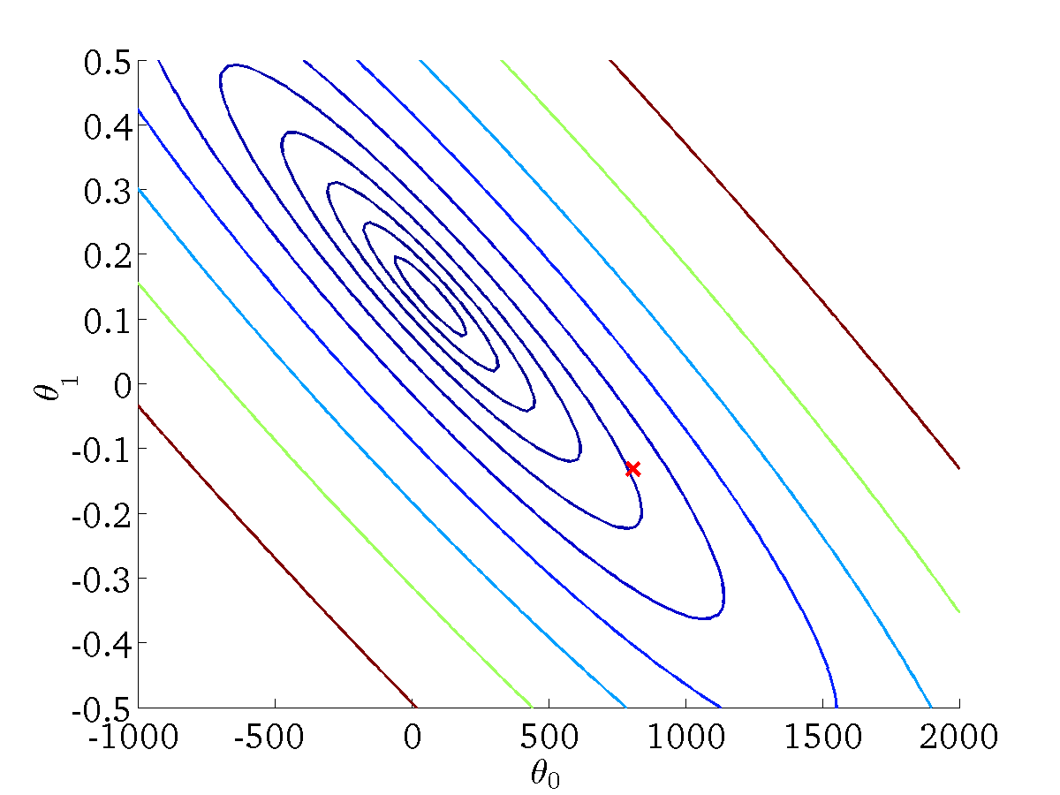

(for fixed , this is a function of x)
(function of the parameters )

Slide 19
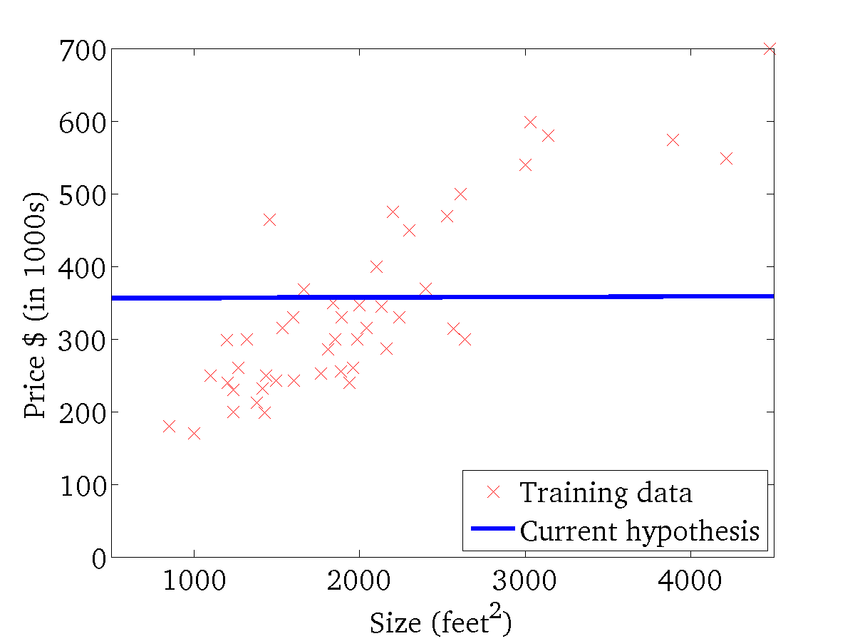
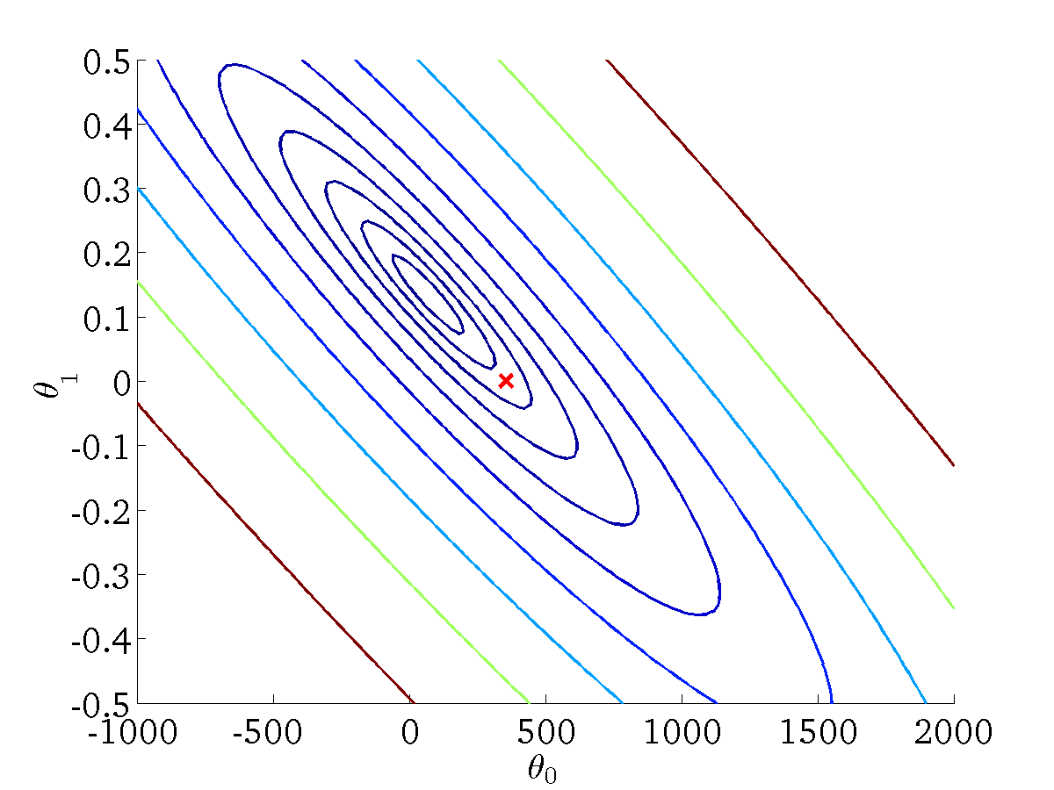
(for fixed , this is a function of x)
(function of the parameters )

Slide 20
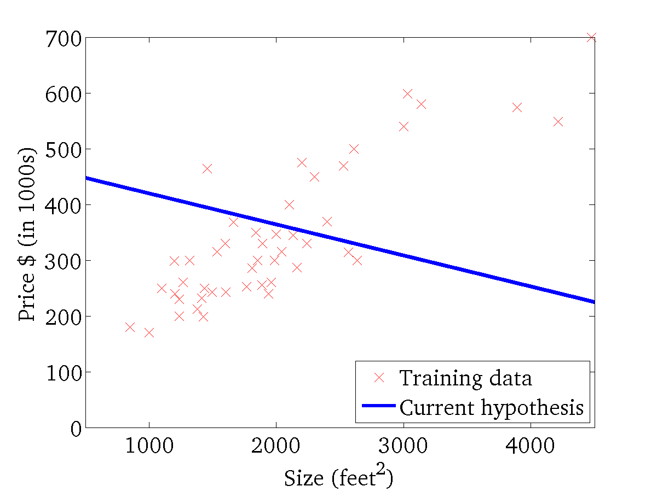

(for fixed , this is a function of x)
(function of the parameters )

Slide 21
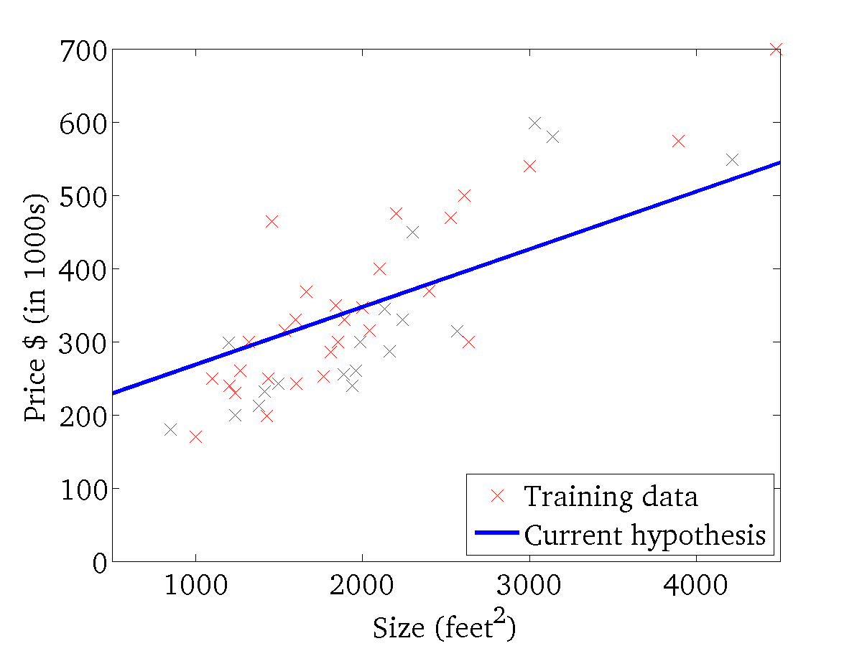
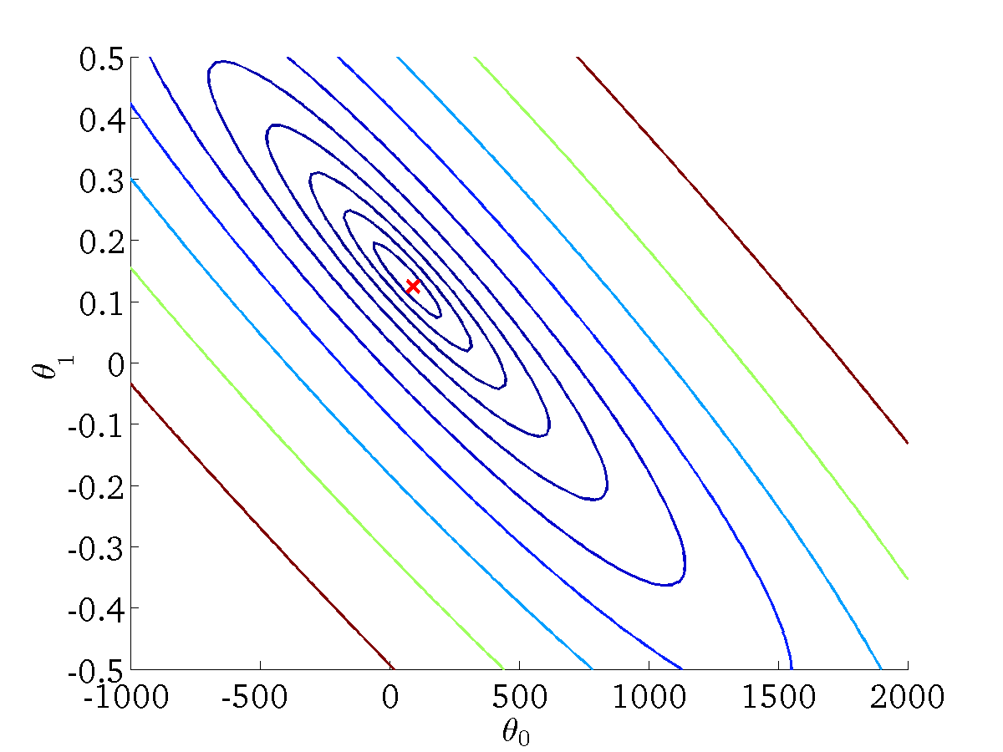
(for fixed , this is a function of x)
(function of the parameters )

Slide 22
Linear regression with one variable
Gradient descent

Slide 23
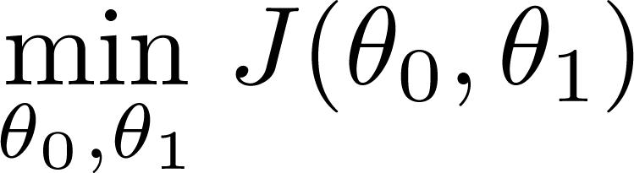
Have some function
Want
Outline:
Start with some
Keep changing to reduce until we hopefully end up at a minimum

Slide 24
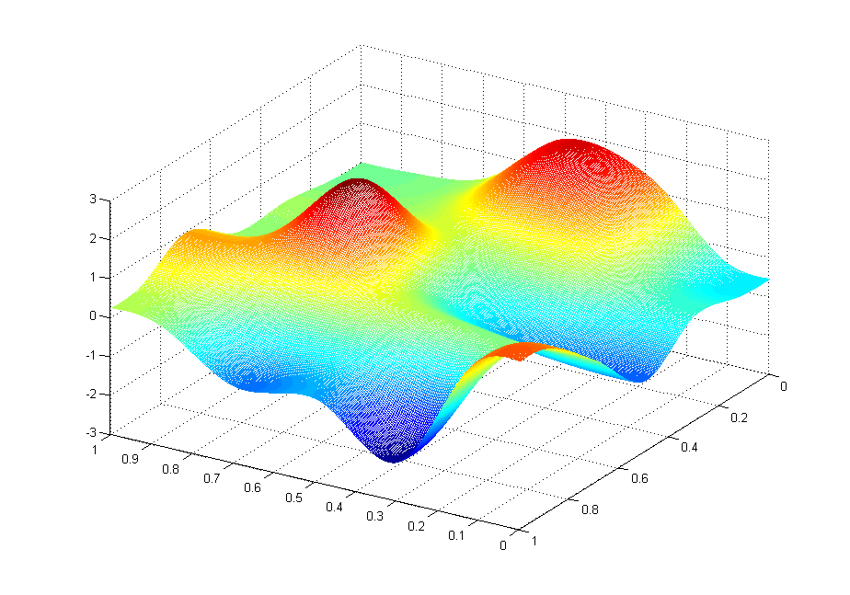
J(θ₀,θ₁)
θ₁
θ₀

Slide 25
J(θ₀,θ₁)
θ₁
θ₀

Slide 26
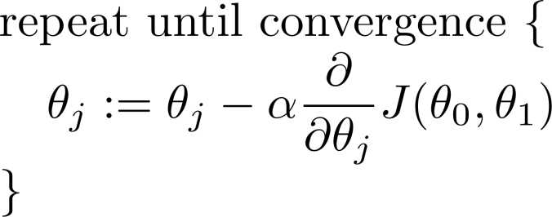
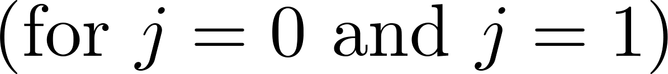
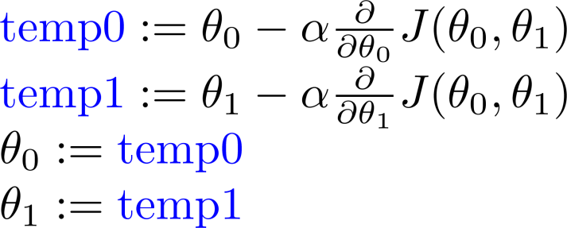
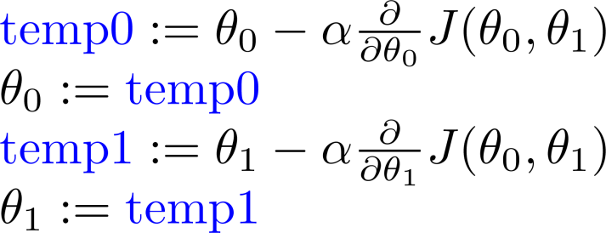









Gradient descent algorithm
Correct: Simultaneous update
Incorrect:

Slide 27
Linear regression with one variable
Gradient descent intuition

Slide 28
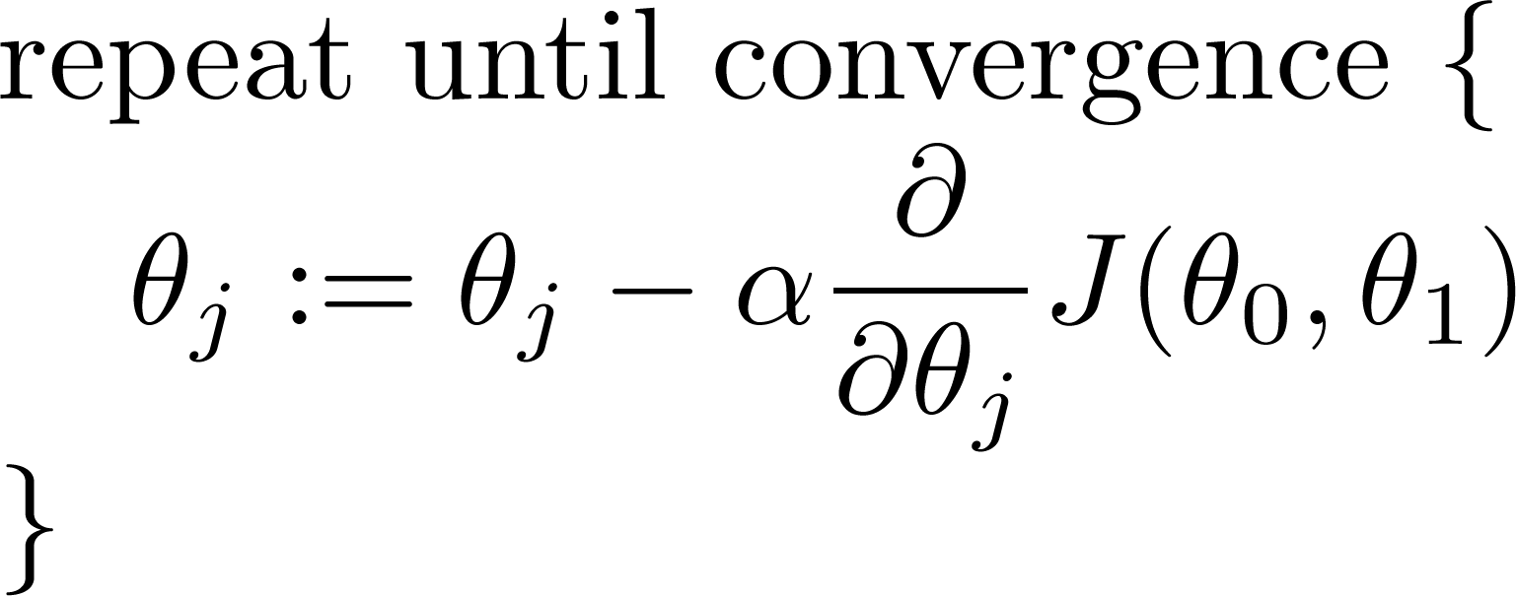
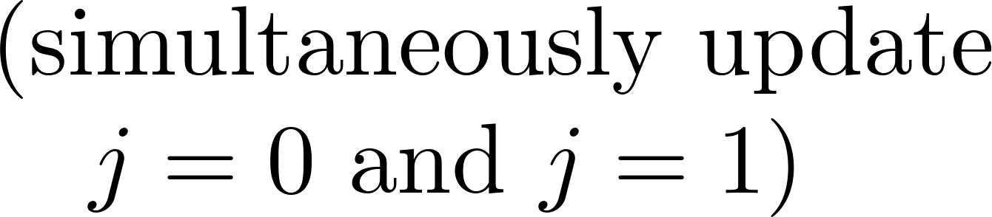




Gradient descent algorithm

Slide 29


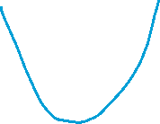












Slide 30
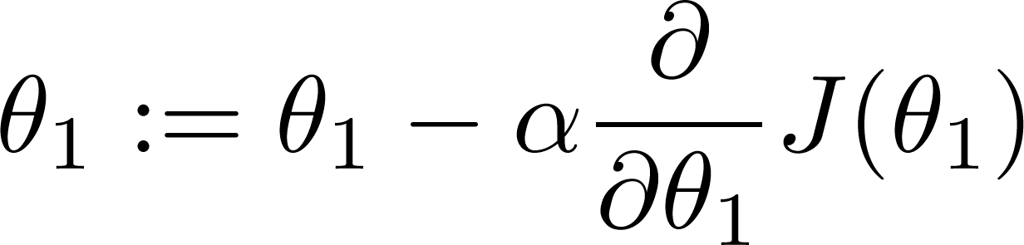
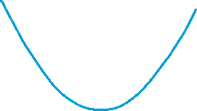




If α is too small, gradient descent can be slow.
If α is too large, gradient descent can overshoot the minimum. It may fail to converge, or even diverge.

Slide 31

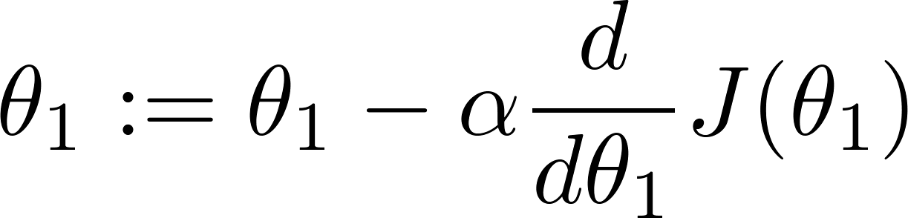




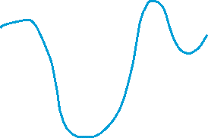



at local optima
Current value of

Slide 32
Gradient descent can converge to a local minimum, even with the learning rate α fixed.
As we approach a local minimum, gradient descent will automatically take smaller steps. So, no need to decrease α over time.

Slide 33
Linear regression with one variable
Gradient descent for linear regression

Slide 34
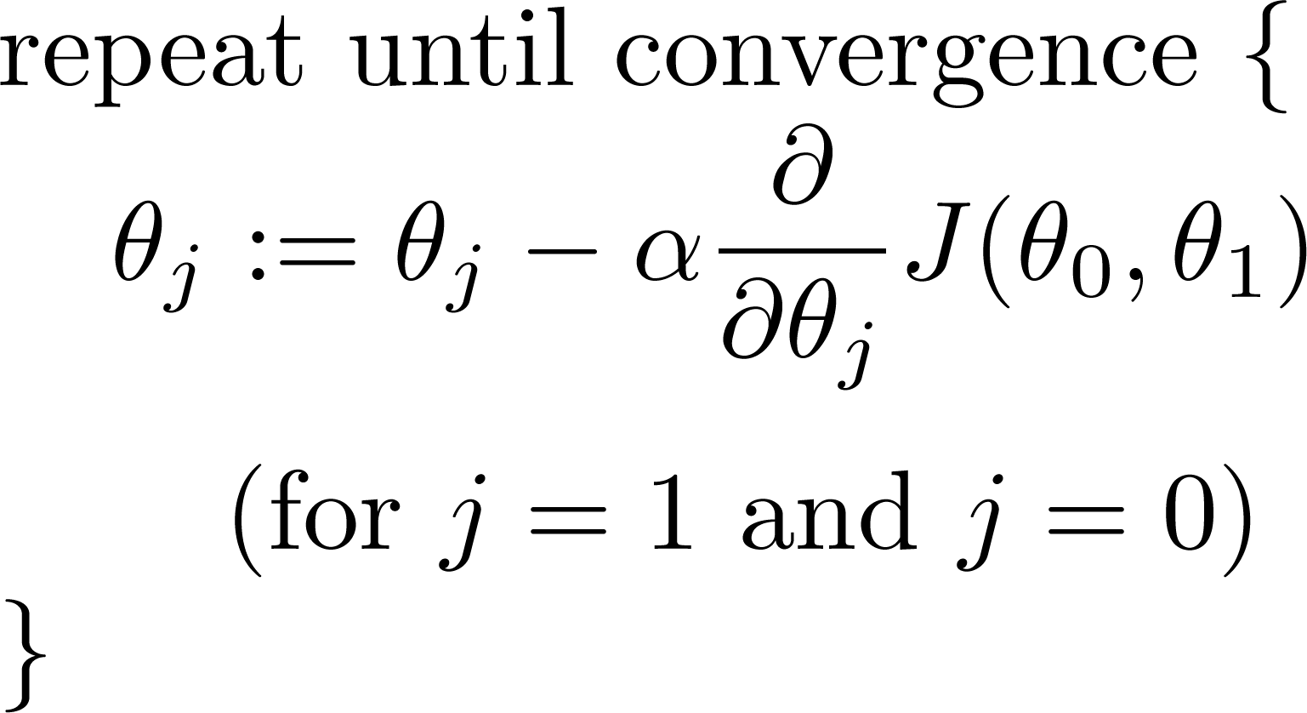
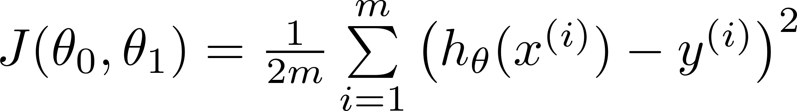

Gradient descent algorithm
Linear Regression Model

Slide 35
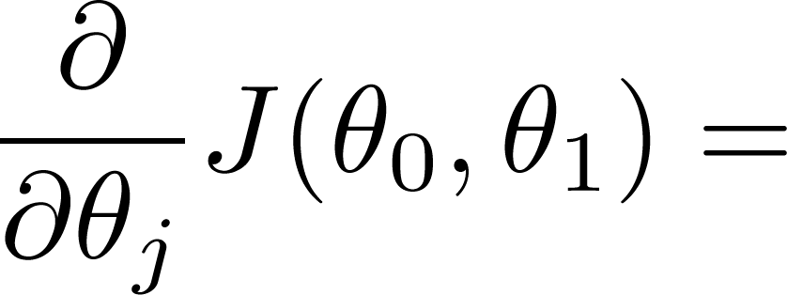
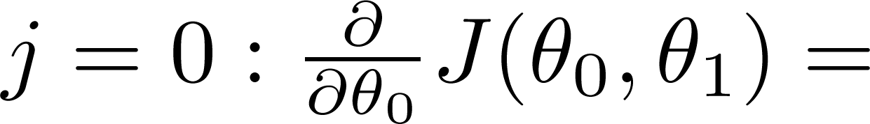
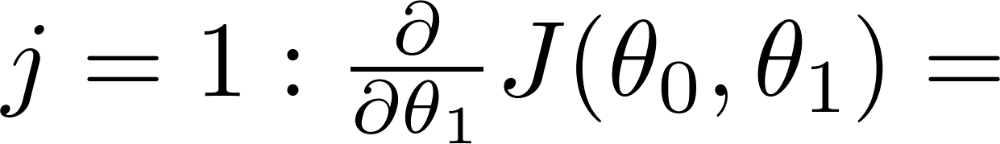







Slide 36
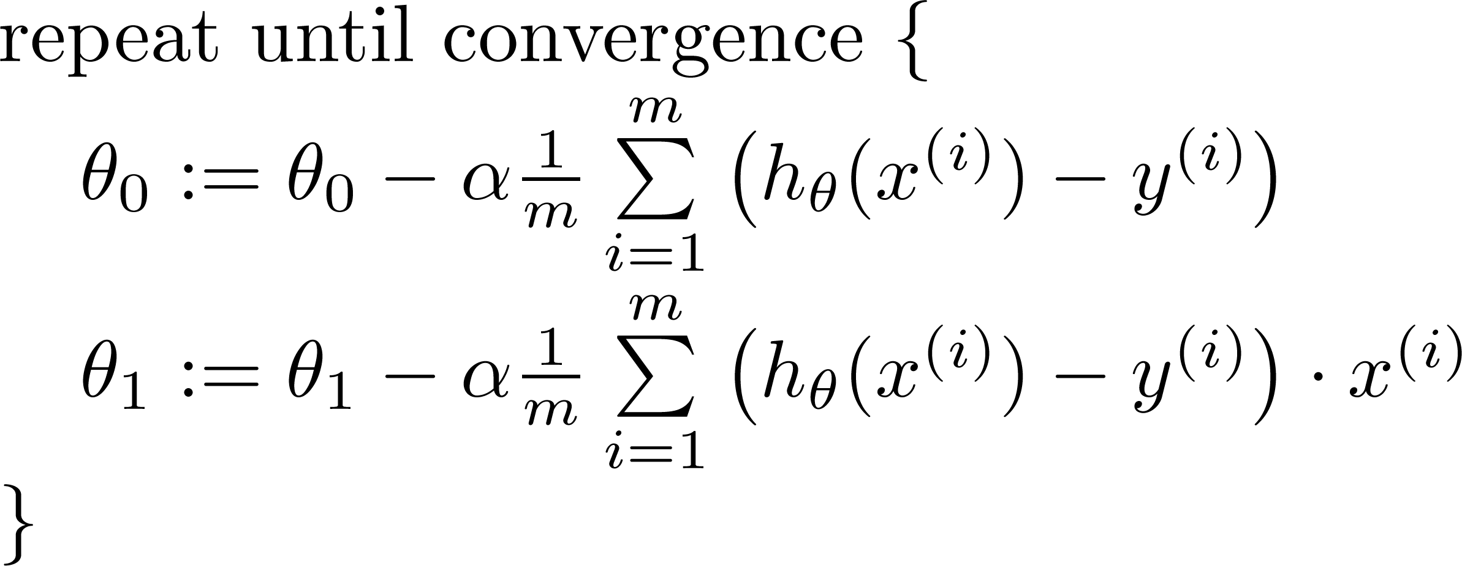






Gradient descent algorithm
update
and
simultaneously

Slide 37


J(θ₀,θ₁)
θ₁
θ₀

Slide 38
J(θ₀,θ₁)
θ₁
θ₀

Slide 40
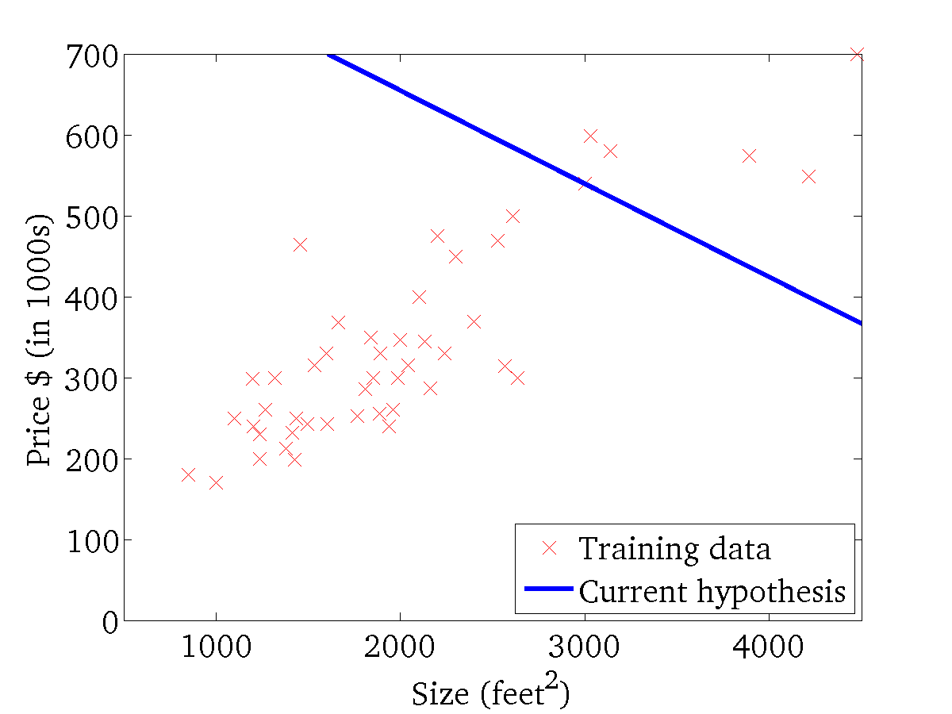
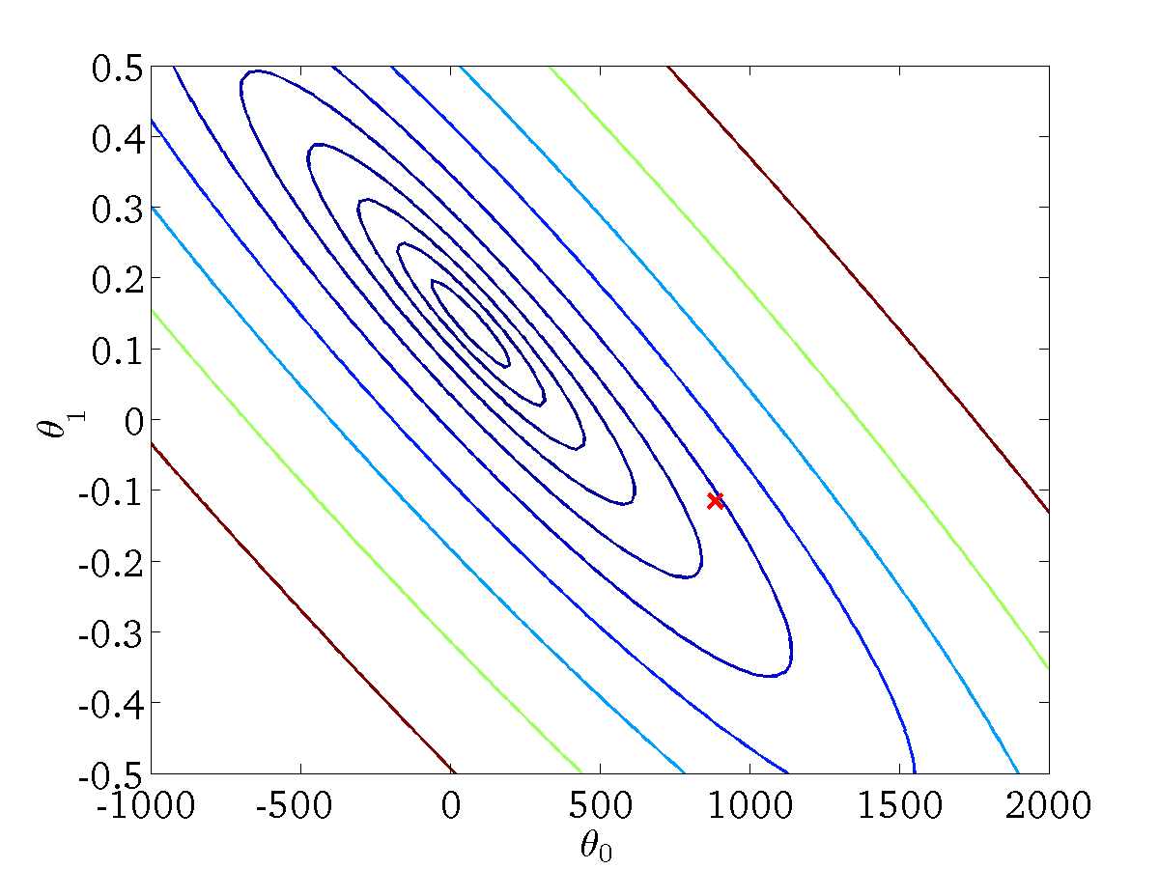
(for fixed , this is a function of x)
(function of the parameters )

Slide 41

(for fixed , this is a function of x)
(function of the parameters )

Slide 42
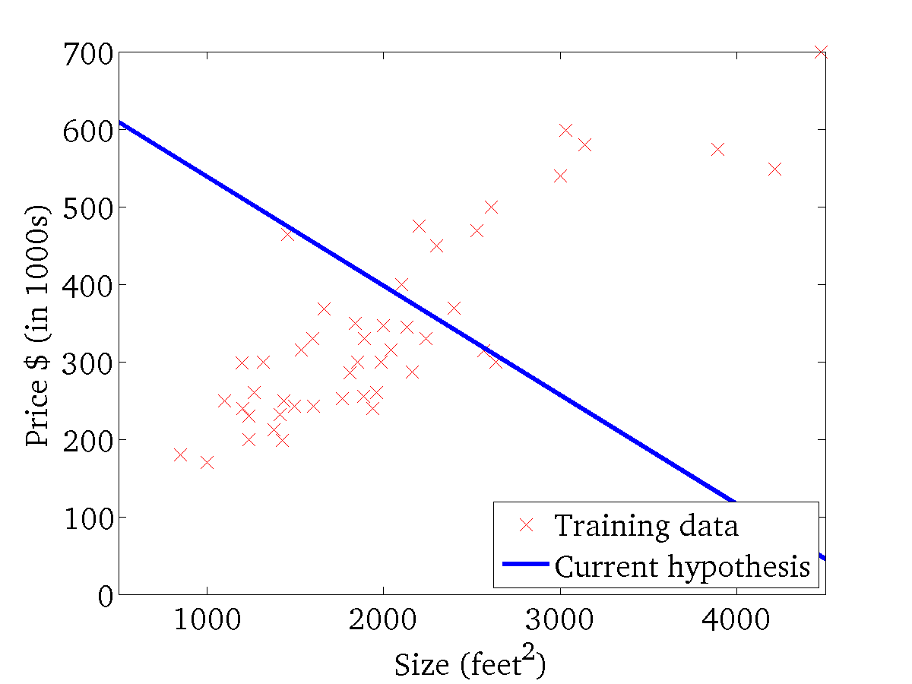
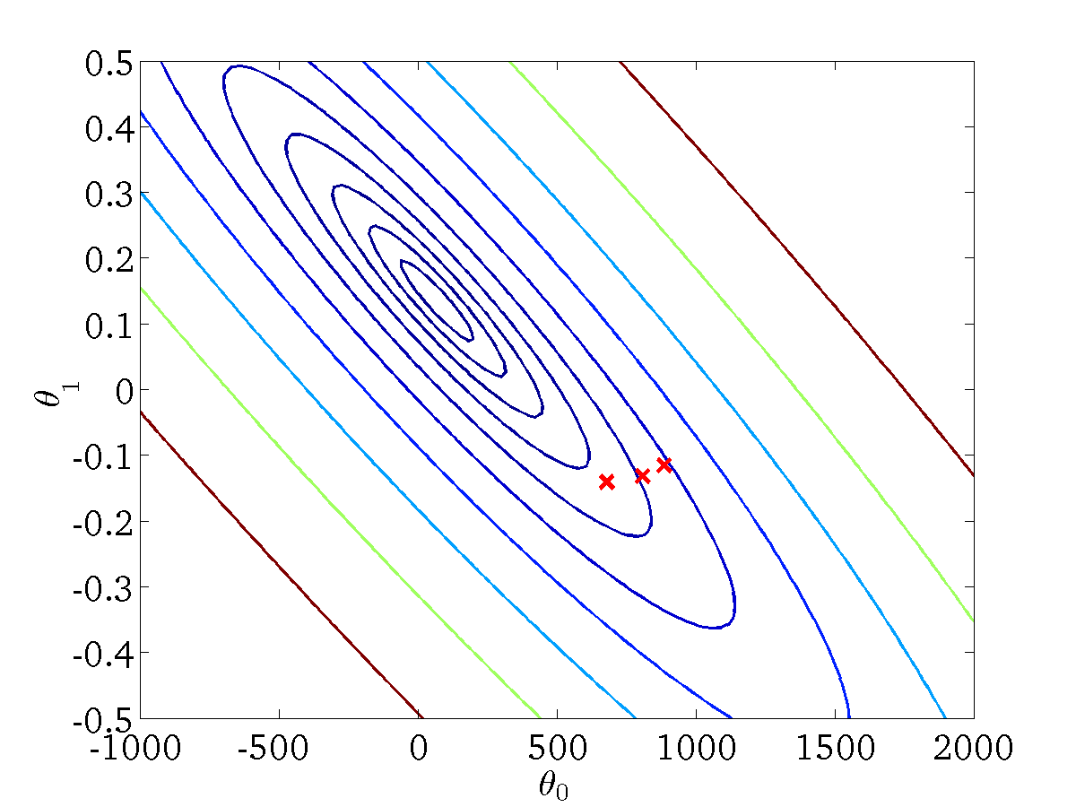
(for fixed , this is a function of x)
(function of the parameters )

Slide 43
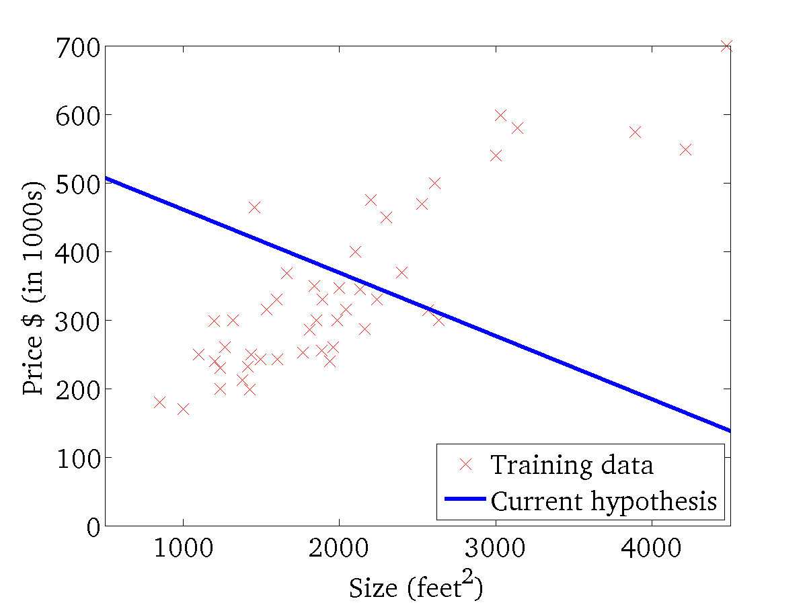

(for fixed , this is a function of x)
(function of the parameters )

Slide 44
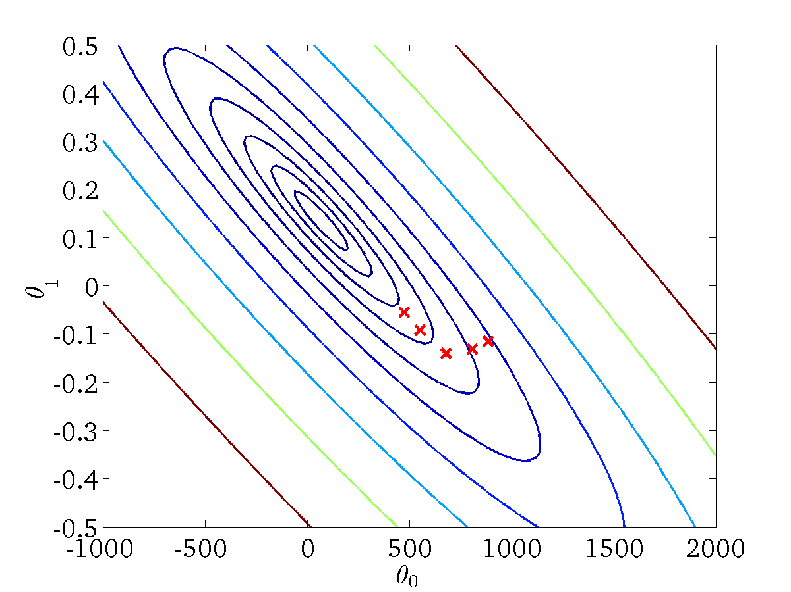
(for fixed , this is a function of x)
(function of the parameters )

Slide 45

(for fixed , this is a function of x)
(function of the parameters )

Slide 46
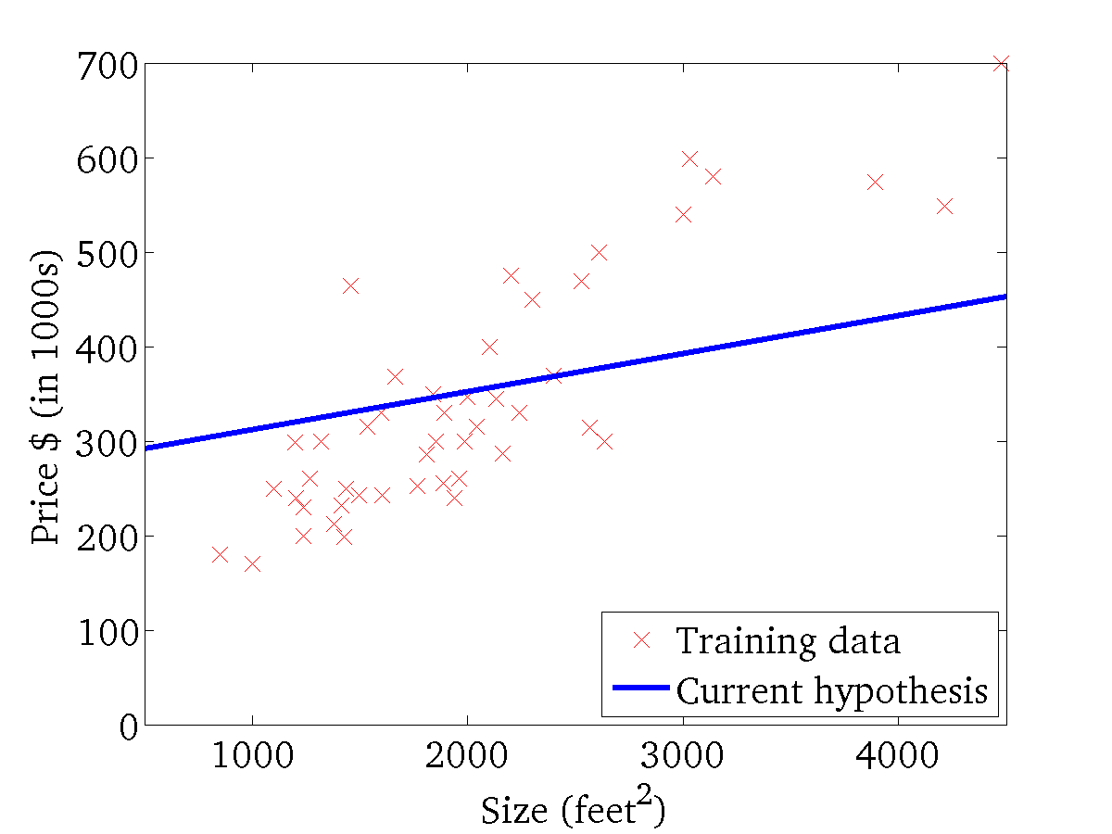

(for fixed , this is a function of x)
(function of the parameters )

Slide 47

(for fixed , this is a function of x)
(function of the parameters )

Slide 48


(for fixed , this is a function of x)
(function of the parameters )

